Slide 1
Enhancing Consumer Decision-Making: An Integrated Approach to E-commerce Platforms Report PERAM SREE KEERTHAN REDDY EE20BTECH11040 ee20btech11040@iith.ac.in

Slide 2
Motivation & Introduction
E-Commerce Revolution & Consumer Challenge:
The exponential growth of e-commerce platforms has transformed retail, granting consumers access to a vast array of products and services.
However, this abundance has led to a psychological challenge known as 'e-confusion' or customer confusion, hindering informed purchasing decisions.
Global Surge in E-Retail Sales and Its Implications:
E-retail sales crossed 5.2 trillion USD globally in 2021, showcasing the monumental rise in online commerce
Underlying Principles of E-Confusion:
Key elements include similarity confusion, overload confusion, and unclarity confusion, all of which compound the challenge of navigating numerous e-commerce options.
Factors Influencing Consumer Behavior, Especially in Emerging Markets:
In markets like India, factors like product pricing, ratings, reviews, and availability play a substantial role in consumer decision-making.
Objective: Integrating Data Analytics for Consumer Decision-Making:
The presentation aims to focus on tackling consumer indecision through an integrated approach that utilizes data analytics methodologies.
This includes delving into sentiment analysis, particularly using Support Vector Machines (SVM), to categorize sentiments expressed in product reviews and aid businesses in making data-driven decisions.

Slide 3
Problem Description and High-level Design
The rapid expansion of e-commerce platforms has led to 'e-confusion'—a psychological challenge for consumers, characterized by difficulty in making informed purchasing decisions due to overwhelming product choices, necessitating solutions for enhancing the online shopping experience.
High-level design (HLD)
SVM Model
For Sentimental
Analysis
Input: Keyword
Data Set
Best Product Recommended

Slide 4
Methodology
Input: Keyword
Data Collection
Data Preprocessing
Tokenization
Stop word filtering
Data Analysis
POS tagging
Sentiment
Stemming
Positive
Neutral
Negative
Best Product
Workflow of the model

Slide 5
Data-Set Description
Amazon products (Scrapped)
User Review Data (Scrapped)
Processed Data ( Along with sentiment and POS tagging)
Product based reviews
Final Processed data with NoA/NoV phrases and sentiment analysis
Amazon Products
Product based reviews
Combined reviews
Processed Data
Product based reviews
Product based reviews
Data Processing Workflow

Slide 6
Model Description & Training Paradigm
Support Vector Machine model is used for training the data.
The training Paradigm is Supervised learning
The Implementation code is here.
The Link for the data set is here.

Slide 7
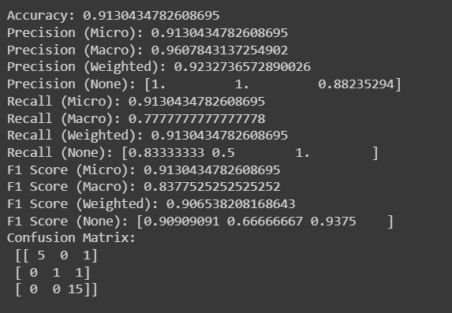
Experimental Results

Slide 8
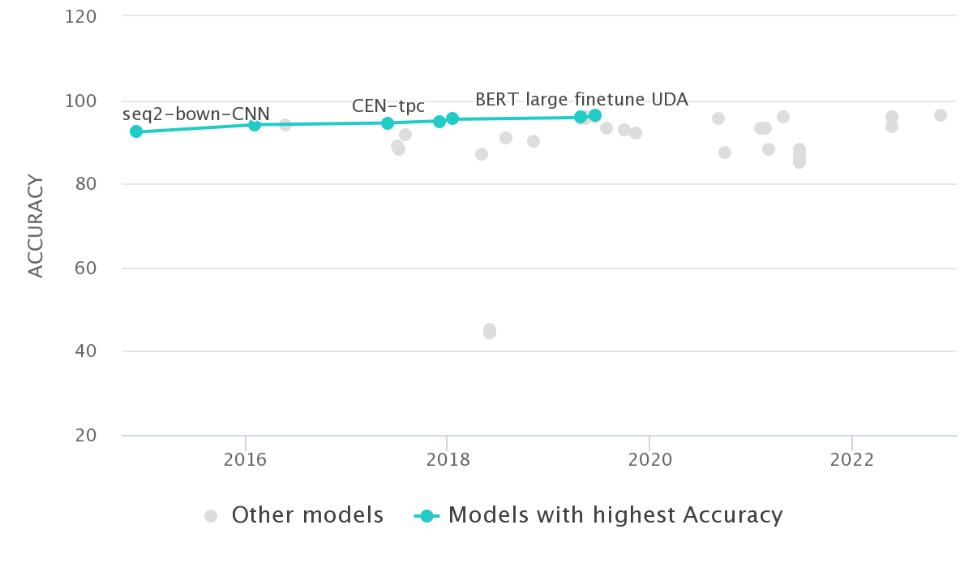
Conclusion and Future work
The average accuracy of our model comes out to be around 85%.
As we can see some more accurate models can be implemented and experimented.
Further this model can be extended to compare products between various e-commerce platforms.
*NOTE*: Accessing/Scraping e-commerce data may lead to the blocking of your IP address by the platform due to huge traffic in less time, So please take care of that while collecting the data ,
https://paperswithcode.com/sota/sentiment-analysis-on-imdb

Slide 9
References
[1] Q. Xie, Z. Dai, E. Hovy, M.-T. Luong, and Q. V. Le, “Unsupervised data augmentation for consistency training,” 2020. [2] D. S. Sachan, M. Zaheer, and R. Salakhutdinov, “Revisiting lstm networks for semi-supervised text classification via mixed objective function,” Proceedings of the AAAI Conference on Artificial Intelligence, vol. 33, p. 6940–6948, July 2019. [3] Z. Yang, Z. Dai, Y. Yang, J. Carbonell, R. Salakhutdinov, and Q. V. Le, “Xlnet: Generalized autoregressive pretraining for language understanding,” 2020. [4] J. Jabbar, I. Urooj, W. JunSheng, and N. Azeem, “Real time sentiment analysis on e-commerce application,” in 2019 IEEE 16th International Conference on Networking, Sensing and Control (ICNSC), pp. 391–396, 2019. Other References 1. https://www.geeksforgeeks.org/web-scraping-amazon-customer-reviews/ 2. https://www.geeksforgeeks.org/scraping-amazon-product-information-using-beautiful-soup/ 3. https://www.datasciencecentral.com/how-to-scrape-amazon-product-data/

